Slide 1

2020 APPRENTICESHIP CONFERENCE
``
THE FUTURE STARTS HERE

Slide 2
Youth Apprenticeship Building North Carolina’s Talent pipeline
Durham, north Carolina
March 5, 2020
Notes:
Thank you Mary
Pleasure to be here

Slide 3


WHAT IS NEW AMERICA?
Nonpartisan research organization headquartered Washington, DC
Education Policy Program includes PreK-12, Higher Education, and Center on Education and Skills at New America (CESNA) teams
  Research, analyze and communicate education and workforce policy trends & challenges
  Engage with policymakers to develop policy solutions
  Elevate work of “doers” and support dissemination of good practice and innovative approaches

Slide 4
Expanding youth apprenticeship is a strategy for building a more inclusive economy by connecting the learning needs of students with the talent needs of industry.
The Partnership to Advance Youth Apprenticeship (PAYA) is a multi-year initiative that will support efforts in states and cities to expand access to high-quality apprenticeship opportunities for high school age youth.

Slide 5


PaYA Funding Partners

Slide 6
Why youth apprenticeship, why now?

Slide 7
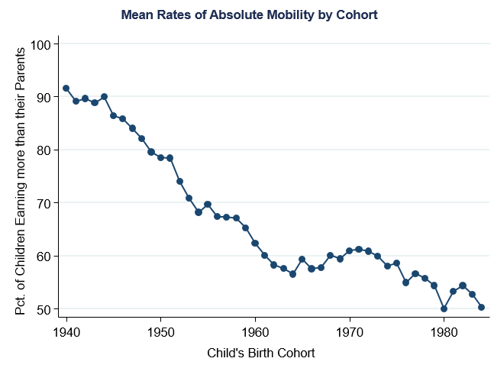
A Generational Challenge

Slide 8
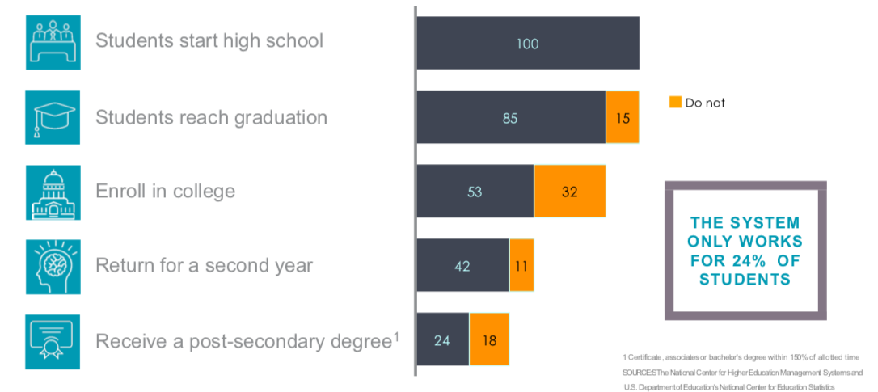
Notes:
Not enough are completing

Slide 9
“Since I became a senior everyone is like, “Where are you going to college?” It’s the first question they ask, automatically. And if my answer or anyone’s answer for that matter doesn’t match the preconceived vision of what they think our futures should look like, they are taken aback—and then you can feel pretty terrible.”
- Allison, Denver High School Student

Slide 10
Public Support for Apprenticeship
Public 4-yr colleges |  | Apprenticeship programs |  | Community colleges |  | Private colleges |  | For-Profit colleges
 | Somewhat favorable |  | Somewhat unfavorable
 | Very favorable |  | Very unfavorable

Slide 11
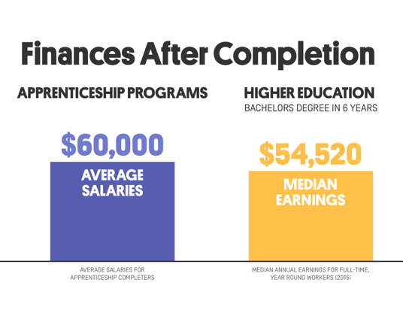

Slide 12
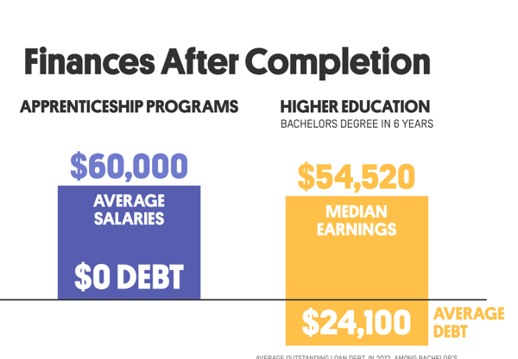

Slide 13
What is a youth apprenticeship?

Slide 14
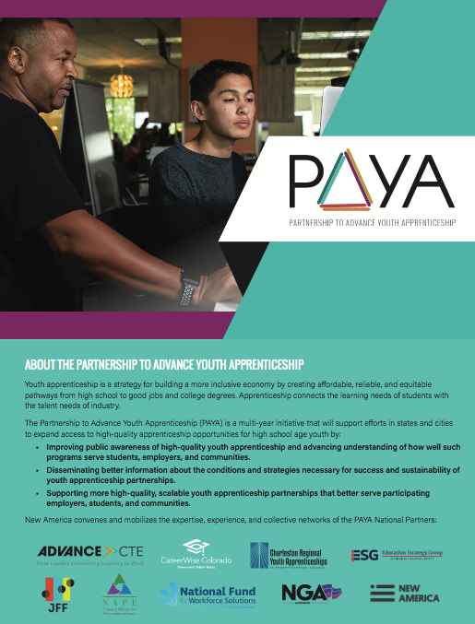
PAYA’s National Principles and Definition for
High-Quality
Youth Apprenticeship

Slide 15
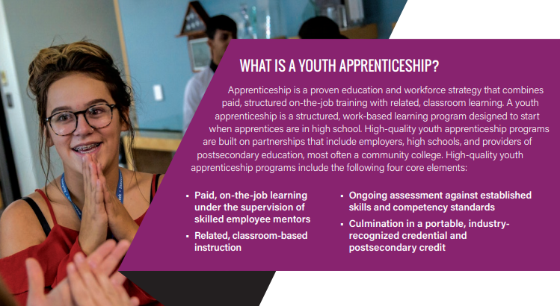

Slide 16
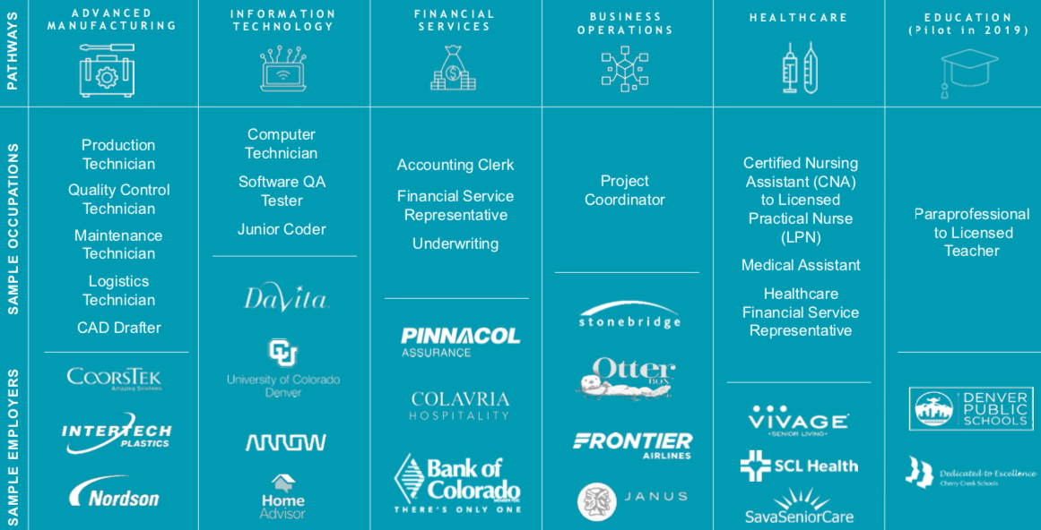

Slide 17
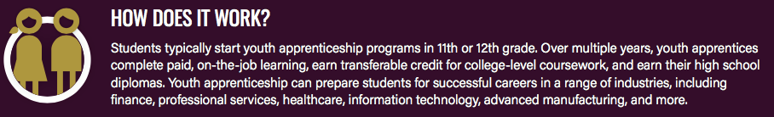
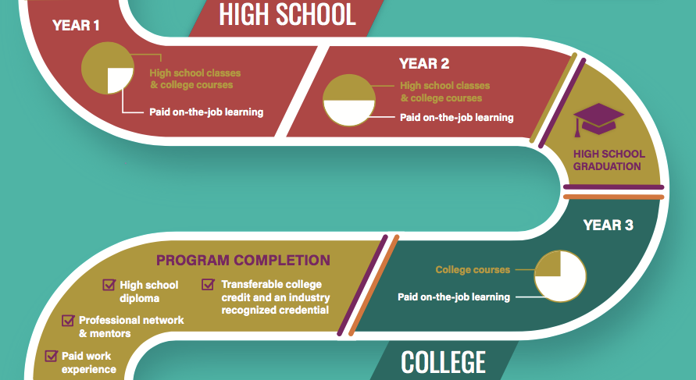

Slide 18
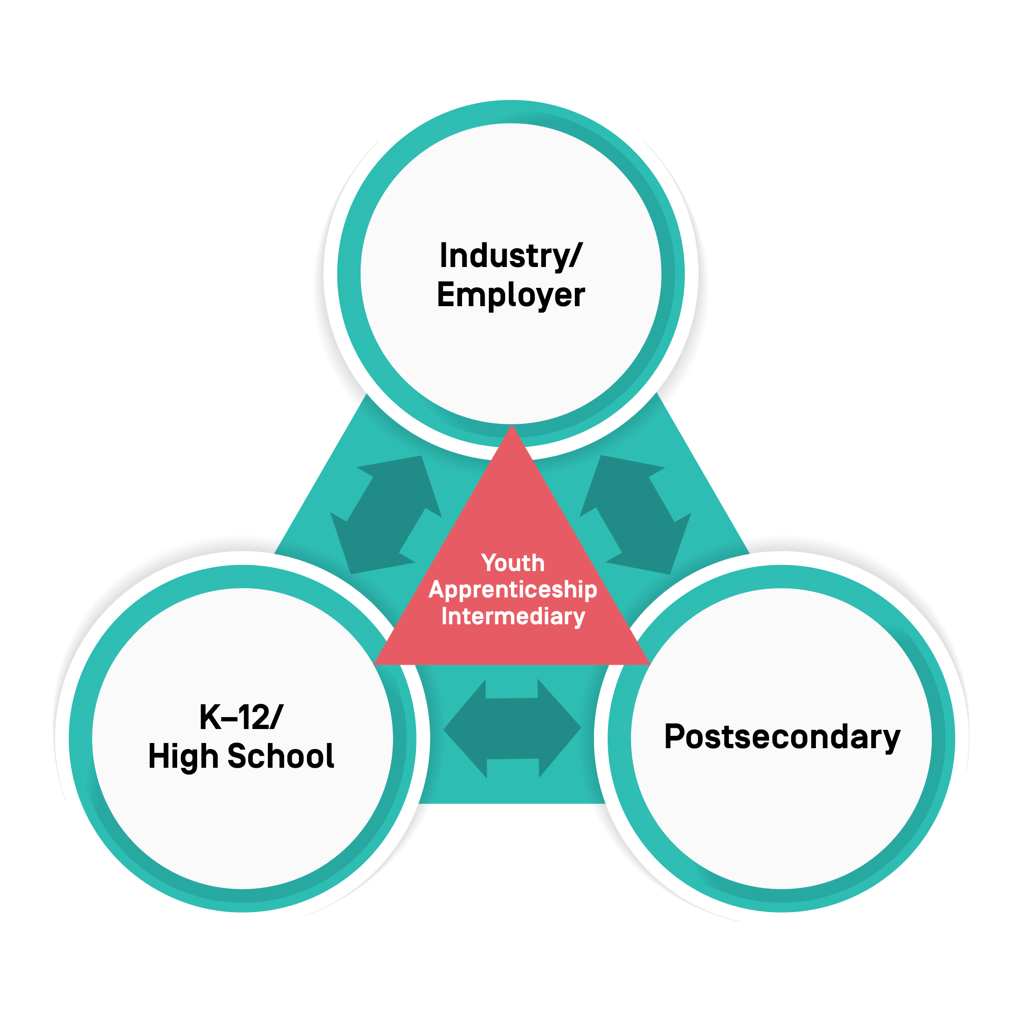
Youth apprenticeship Is A Public-private partnership
Industry & Employers
identify skills requirements, build training plans, and deliver paid on-the-job training
Intermediaries
Coordinate the activity of key partners to support success of employers & apprentices
High Schools
enable on-the-job and help students meet grad requirements
Colleges & Universities
help design and deliver related instruction, assess learning, grant credit and credentials.

Slide 19
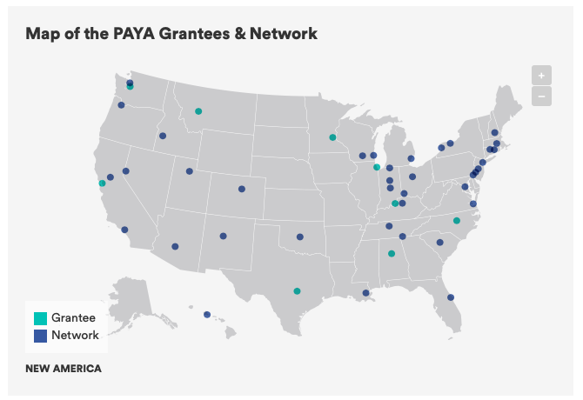

Slide 20
The business case for (growing) youth apprenticeship.

Slide 21
The Business Case
Firm Costs
Apprentice Wages
Training Coursework and Materials
Recruitment and Training Personnel

Slide 22

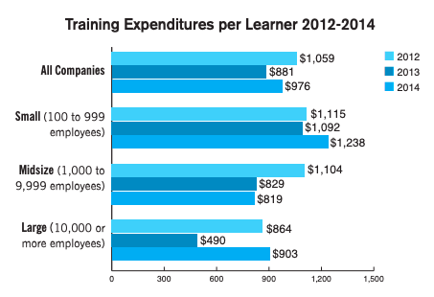
The Case | Some Numbers
Average cost to hire in
the U.S. is $4,161
Average training costs per employee is $1,000 per year

Slide 23

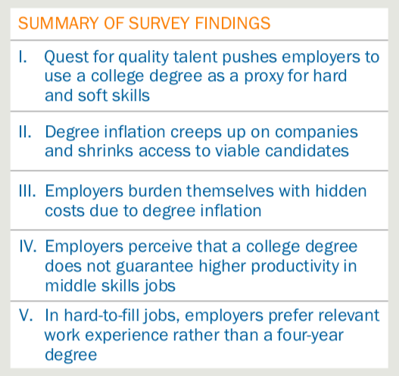
The Case | Hidden Degree Inflation Costs

Slide 24
Firm Costs
Wages
Training Coursework and Materials
Firm Benefits
Retention and Talent Pipeline
Productivity
Recruitment and Training Personnel
The Youth Factor
Reduced Hiring & Training Costs

Slide 25
Firm Costs
Wages
Training Coursework and Materials
Firm Benefits
Retention and Talent Pipeline
Productivity
Recruitment and Training Personnel
The Youth Factor
Reduced Hiring & Training Costs
Culture and Diversity
Innovation
Management Pipeline

Slide 26
Firm Costs
Wages
Training Coursework and Materials
Firm Benefits
Retention and Talent Pipeline
Productivity
Recruitment and Training Personnel
The Youth Factor
Reduced Hiring & Training Costs
In North Carolina…
Youth Coursework thru CTE, North Carolina Tuition Waiver
Youth Apprenticeship Regional Consortia Pool Risk and Costs

Slide 27
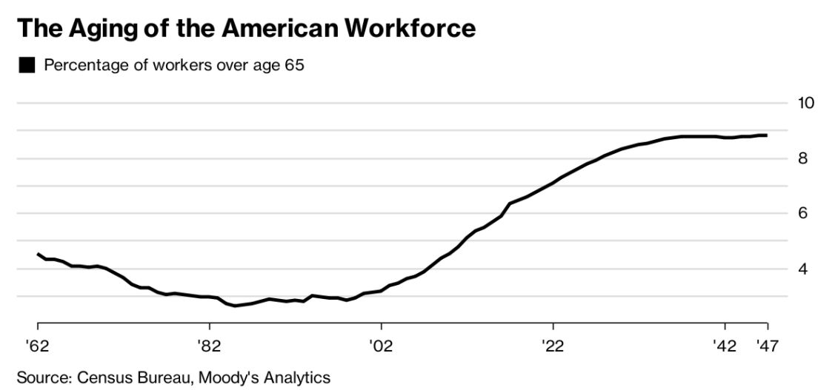
The Case | The Youth Factor

Slide 28
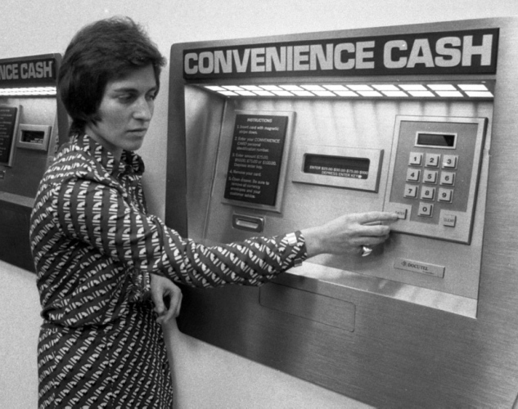
The Case | The Youth Factor

Slide 29
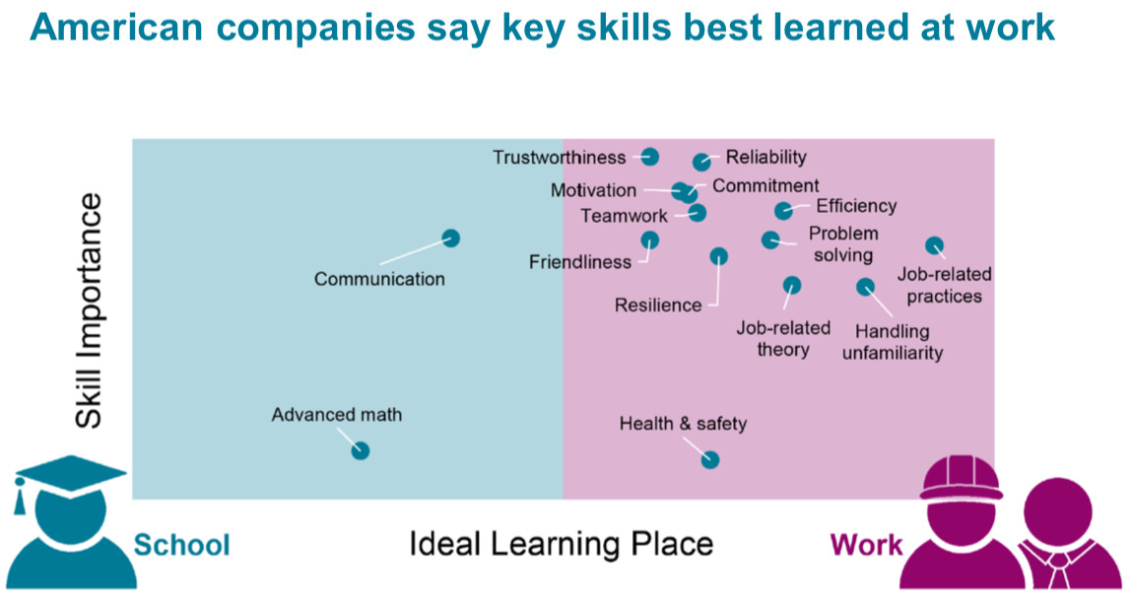
The Case | The Youth Factor

Slide 30
The Case | Growing Youth Apprenticeship
Business to Business Partnership
Business and Education Alignment
A True Youth Apprenticeship System
Notes:
BUT……economc mobility is decling…

Slide 31
Thank You
Reach out:
parton@newamerica.org

