Slide 1
2021 Annual Conference
CONNECT AND BUILD YOUR WORKFORCE
WITH APPRENTICESHIPNC!
Tuesday, April 27th

Slide 2
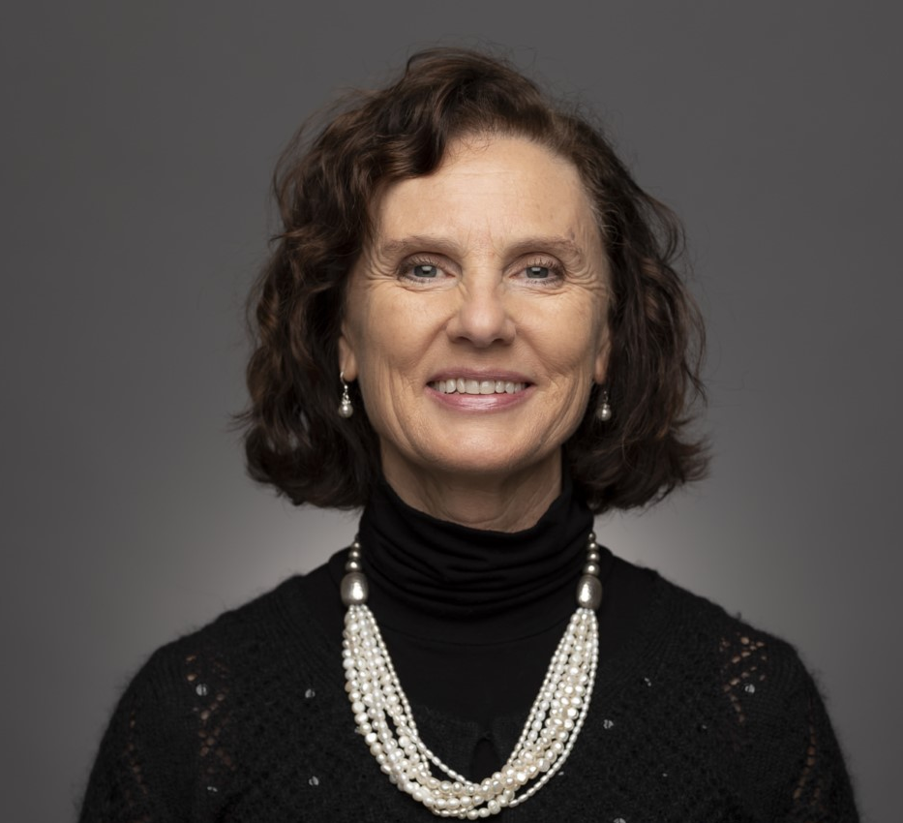
CONNECT AND BUILD YOUR WORKFORCE WITH APPRENTICESHIPNC!
Kathryn Castelloes
Kathryn Castelloes began working with the North Carolina Department of Labor in 1994 in the Pre-Apprenticeship Division. After working there for four years, Kathryn became an apprenticeship consultant with the Apprenticeship and Training Bureau. In 2006, she began working as the Western Field Supervisor and in 2008 she was promoted to the Bureau Chief for Apprenticeship and Training. In 2014, the agency was transferred to the North Caolina Department of Commerce and in 2017 the agency was transferred to the NC Community College System, where she serves as Director of ApprenticeshipNC.
Director
ApprenticeshipNC

Slide 3
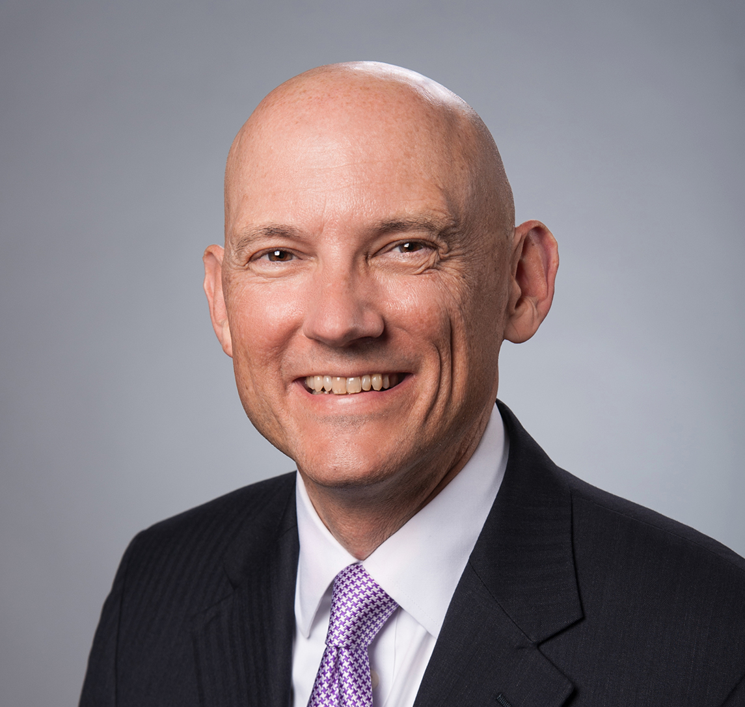
In Memory of Brian Long
ApprenticeshipNC
Communications Director
July 1, 2019 – March 14, 2021

Slide 4
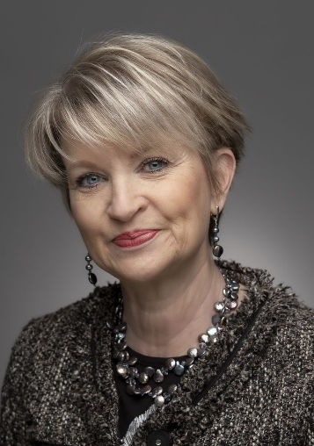
CONNECT AND BUILD YOUR WORKFORCE WITH APPRENTICESHIPNC!
Opening Remarks
Maureen Little
Maureen is Vice-President of Economic Development for the North Carolina Community Colleges. She is responsible for ApprenticehipNC, BioNetwork, Customized Training, and the Small Business Center Network. Ms. Little serves on the NC Economic Development Association Board of Directors and the NC Works Commission Board. She understands the need for collaboration among all workforce partners and works tirelessly promoting our great state as the place for companies to locate, grow and remain globally competitive
Vice-President of
Economic Development
North Carolina
Community Colleges

Slide 5
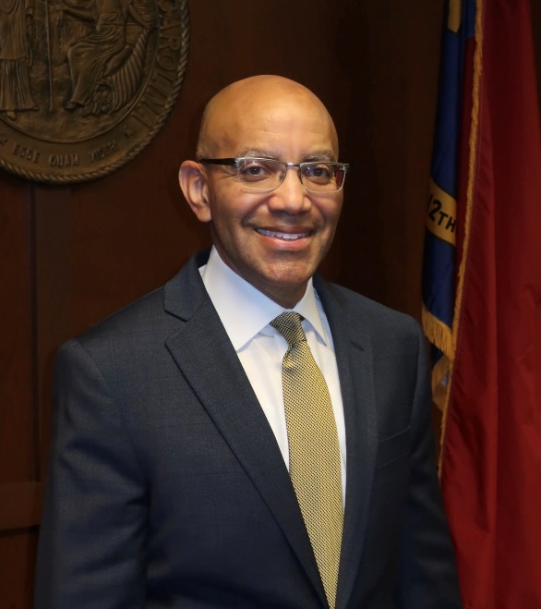
CONNECT AND BUILD YOUR WORKFORCE WITH APPRENTICESHIPNC!
Thomas A. Stith III
Thomas A. Stith III became the 10th President of the NC Community College System on January 11, 2021. Prior to his selection he was district director of the U.S. Small Business Administration, where he led the federal agency’s $16 billion response to COVID-19 in North Carolina. Stith served as chief of staff to former Gov. Pat McCrory and was a three-term city council member in Durham. Stith has extensive experience in both private and public sector executive roles during his professional career. Stith holds a bachelor’s degree in management and an MBA in marketing from North Carolina Central University. He has served on the boards of the Golden LEAF Foundation, the North Carolina Institute of Political Leadership, the United Way of the Greater Triangle, North Carolina Leadership Forum member and is a deacon at Union Baptist Church.
President
NC Community College System

Slide 6
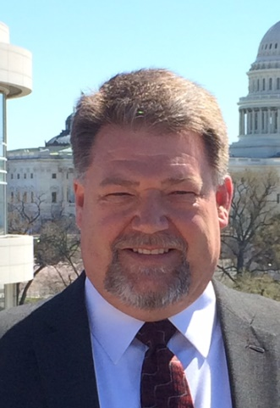
CONNECT AND BUILD YOUR WORKFORCE WITH APPRENTICESHIPNC!
Master of Ceremonies
Roger Collins
He is the Apprenticeship Manager and Technical Training Specialist for Siemens Energy, Inc. in Charlotte, N.C. He manages Apprenticeship Siemens and the technical training of more than 1,400 employees at the advanced manufacturing facility. Roger is a graduate of The Apprentice School at Newport News Shipbuilding, a Journeyman Machinist and currently serves on the Charlotte Works Board of Directors. He is the Chairman of the North Carolina Apprenticeship Council and, recently was named co-chair of the State Apprenticeship Council Alliance, an advisory group to the U.S. Department of Labor Office of Apprenticeship.
Apprenticeship Manager and Technical Training Specialist
Siemens Energy, Inc.

Slide 7
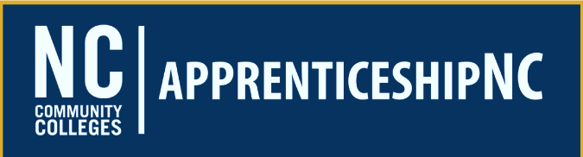
Day 1 Agenda
2021 Annual Conference
Learn How ApprenticeshipNC
Can Help You Build Your Workforce
TIME | EVENT
8:25am | Conference Opens
8:30am | Welcome from NCCCS President Thomas A. Stith III
8:35am | Opening Speaker: John Ladd, Peyton Holland
9:20am | Outstanding Registered Apprentice recognition
9:25am | Demystifying Apprenticeship
10:25am | Special Recognition
10:30am | You have an Apprenticeship Program, Now What?
11:25am | Outstanding High School Apprentice recognition
11:30am | Tailor Made: Using Apprenticeship to Get the Right Fit
12:25pm | Day’s Conclusion and Question and Discussion

Slide 8
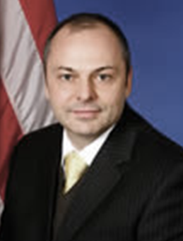
CONNECT AND BUILD YOUR WORKFORCE WITH APPRENTICESHIPNC!
Opening Speaker
John Varian Ladd
John Varian Ladd became Administrator of the Office of Apprenticeship (OA) in January 2008. As OA Administrator, John has responsibility for oversight of the National Registered Apprenticeship System. Prior to his appointment as Administrator, John served as the Deputy Administrator for the Office of National Response and the Director of Regional Management in the Office of Field Operations.
John has been in numerous leadership positions for major ETA initiatives including the Workforce Innovations in Regional Economic Development (WIRED), Innovation University InnovatETA, and ETA’s Transformational Forums.
Administrator of the Office of Apprenticeship (OA)
U.S. Department of Labor

Slide 9
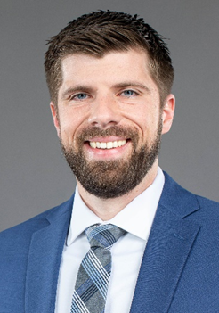
CONNECT AND BUILD YOUR WORKFORCE WITH APPRENTICESHIPNC!
Opening Speaker
Peyton Holland
Peyton Holland is Executive Director of the National Technical Honor Society, a non-profit dedicated to celebrating and empowering students in all areas of career and technical education. Prior to that, he served as the Executive Director of SkillsUSA North Carolina, a non-profit that leads efforts to prepare students for the workforce through the development of personal, workplace and technical skills. Peyton grew up in rural North Carolina, learning the value of hard work and skill early in life.
From the lessons he learned on the farm and at the family sawmill, to the experiences Peyton gained traveling internationally and acquiring a Master’s in Business Administration and Global Innovation Management. He brings a unique perspective to the conversation of education, workforce development and economic growth.
Executive Director
National Technical Honor Society

Slide 10
Award for:
Outstanding Registered Apprentice

Slide 11
Video here

Slide 12

Outstanding Registered Apprentice
Caleb Baudoin,
Hubbell Industrial Controls, Inc.

Slide 13
2021 Annual Conference
Demystifying Apprenticeship

Slide 14
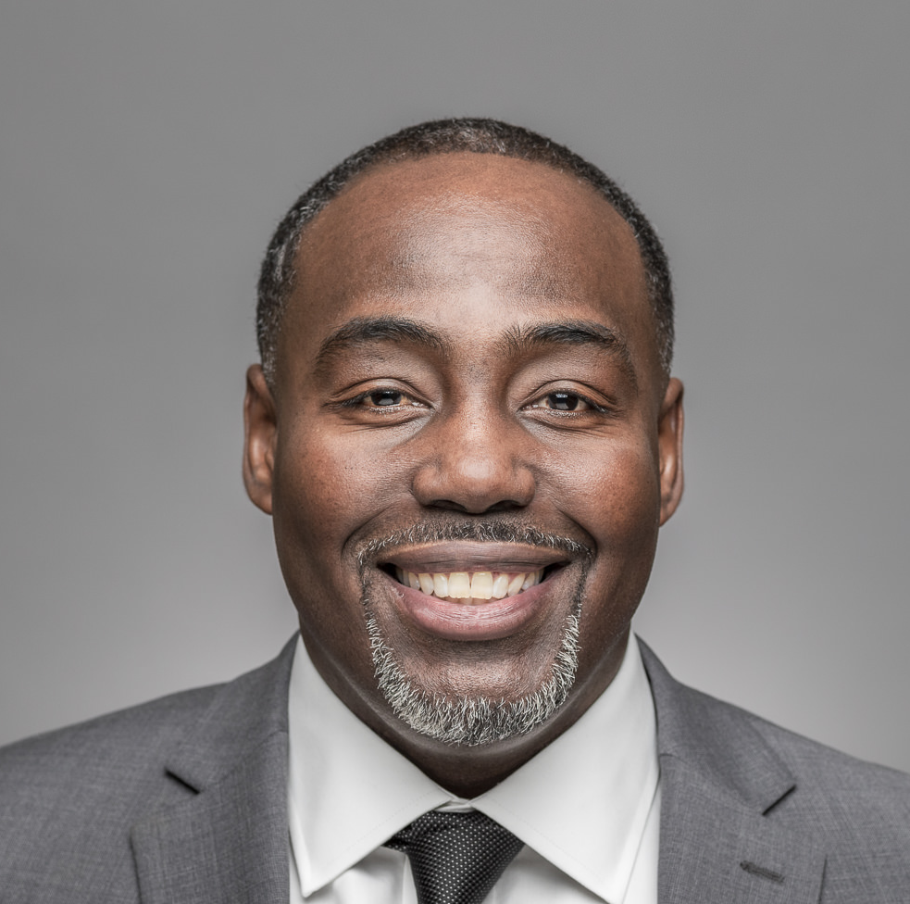
CONNECT AND BUILD YOUR WORKFORCE WITH APPRENTICESHIPNC!
Demystifying Apprenticeship
Antwan Pippen
Workshop Moderator
Apprenticeship Consultant
ApprenticeshipNC

Slide 15
CONNECT AND BUILD YOUR WORKFORCE WITH APPRENTICESHIPNC!
Demystifying Apprenticeship
Tony Marshall
Tony is President & CEO of Innovative Systems Group Inc. providing cybersecurity services. He previously worked in various IT-related positions from software developer to project management for Mobil Oil, Bell Atlantic, Discovery Communications and others. Under his leadership, the Raleigh-based ISG has developed one of the first Cybersecurity Apprenticeship Programs in the country, often working with transitioning veterans.
President & CEO
Innovative Systems Group

Slide 16
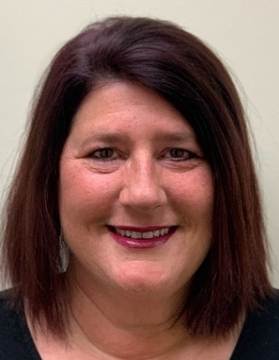
CONNECT AND BUILD YOUR WORKFORCE WITH APPRENTICESHIPNC!
Demystifying Apprenticeship
Danielle Martini
Danielle as President started Three Way Plumbing over 20 years ago with her husband. She is a big proponent of educating the public about how great plumbing and the trades are for a career. Three Way Plumbing is a registered apprentice program as well as GI Bill approved. She also works closely with the non-profit She Built This City pre-apprentice program. Apprenticeships are a great way to earn while you learn and start your life-long career path without incurring lots of debt from attending college for years without ever working in your chosen profession.
President
Three Way Plumbing Services

Slide 17
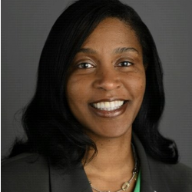
CONNECT AND BUILD YOUR WORKFORCE WITH APPRENTICESHIPNC!
Demystifying Apprenticeship
Cynthia Bailey
Cynthia is responsible for developing and executing strategy for Atrium Health Outside In, Inside Up economic mobility programs. These programs create career pathways for current teammates and connect community members with careers at Atrium Health. Each program aims to reduce poverty, a social determinant of health. She has worked for more than 20 years in HR, in government and health care industries, with specific experience in Workforce Development, Employee Wellness and Benefits, Learning Organizational Development, Labor Management and Employee Relations.
Sr. HR Consultant
Atrium Health

Slide 18
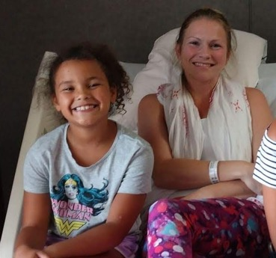
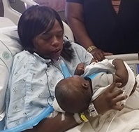
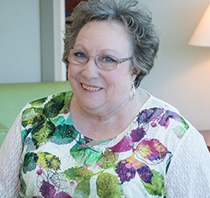
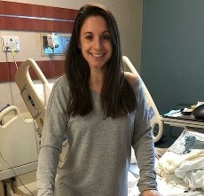
About
Atrium Health
To improve health, elevate hope and advance healing for all
55,500+
Teammates
36
Hospitals
44
Urgent Care Locations
35
EDs
32
Cancer Care Locations
3,100+
Providers
15,000+
Nurses
Locations:
North Carolina, South Carolina, and Georgia
*Includes Joint Venture and Affiliated Enterprises

Slide 19
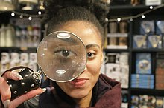
Demystifying Apprenticeship
November 2020: Registered for Surgical Tech Apprenticeship
Two additional apprenticeships coming soon
January 2021: Three apprentices began related instruction at Central Piedmont Community College to earn Associate Degree in Surgical Technology

Slide 20
Demystifying Apprenticeship
Why Surgical Technology
  In-demand position
  Establish pathway for entry level positions >
  Sterile Processing Tech > Surgical Technology
Your ApprenticeshipNC Consultant is your best resource
  Approval process and forms
  Resources for Apprentices
Apprenticeship Successes and Lessons learned
  Funding
  Engage the subject matter experts within your organization early and often
  Know admissions and general education course requirements
  Start small
  Secure mentors as early as possible
  Define expectations by creating a participant (apprentice) guide and leader guide

Slide 21
2021 Annual Conference
Demystifying Apprenticeship

Slide 22






















Five Minute Break

Slide 23
2021 Annual Conference
CONNECT AND BUILD YOUR WORKFORCE
WITH APPRENTICESHIPNC!
Tuesday, April 27th

Slide 24
Award for:
Special Recognition

Slide 25
Video here

Slide 26
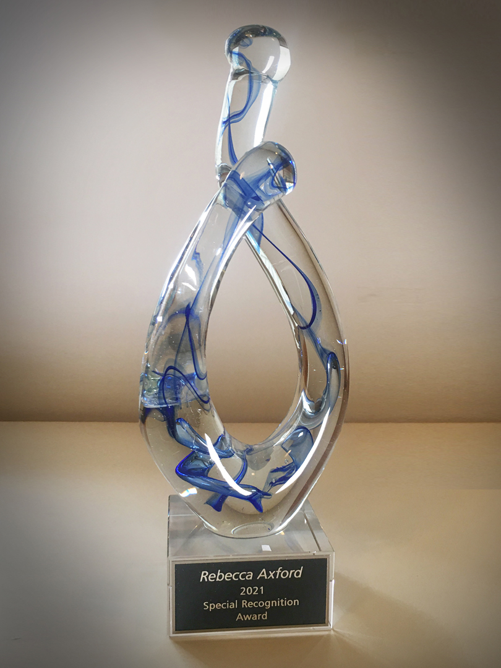
Special Recognition
Rebecca Axford
Rebecca Axford is the Director of the Raleigh-Durham Electrical JATC apprenticeship program, which was registered in Durham, NC in 1980. While the apprenticeship and employment program has been and remains very successful, there were growing concerns about diversifying the talent pool.
In 2018, Ms. Axford registered a pre-apprenticeship program focusing on recruitment of minorities, women, veterans and youth – and partnered with the Durham Workforce Development to populate the first cohort. The JATC had great success in this partnership and partnered on an additional cohort in 2019, and a cohort in 2020 in partnership with Wake County. Ms. Axford believes in the long-term benefit of a mutually beneficial relationship with community organizations to solve industry issues of worker shortage and the skills gap.

Slide 27
2021 Annual Conference
You Have an Apprenticeship, Now What?

Slide 28
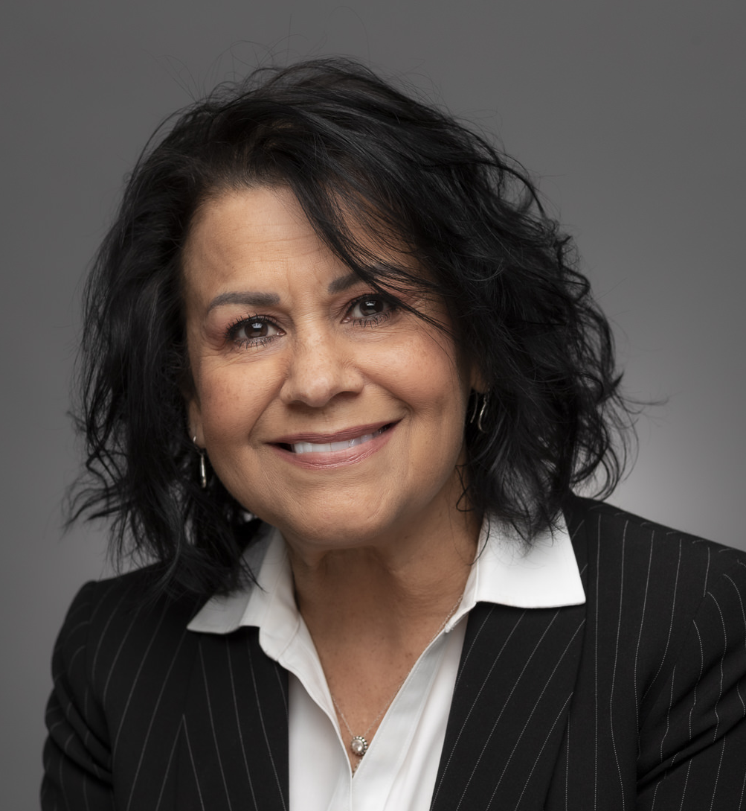
CONNECT AND BUILD YOUR WORKFORCE WITH APPRENTICESHIPNC!
You Have an Apprenticeship, Now What?
Wanda Ramos-McPherson
Workshop Moderator
Apprenticeship Consultant
ApprenticeshipNC

Slide 29
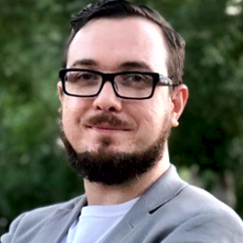
CONNECT AND BUILD YOUR WORKFORCE WITH APPRENTICESHIPNC!
You Have an Apprenticeship, Now What?
Peter Shoun
Peter is the Knowledge Transfer Process Specialist at LC America, Inc, a food manufacturer in Colfax. Peter designs and delivers training, and promotes communication and information access across LC America’s departments. He is active in the Guilford Apprenticeship Partners consortium and supervises a team of youth apprentices who are working to meet the unique challenges of extruded snack pellet manufacturing. Peter is a graduate of the University of Georgia's Terry College of Business.
Knowledge Transfer
Process Specialist
LC America, Inc.

Slide 30
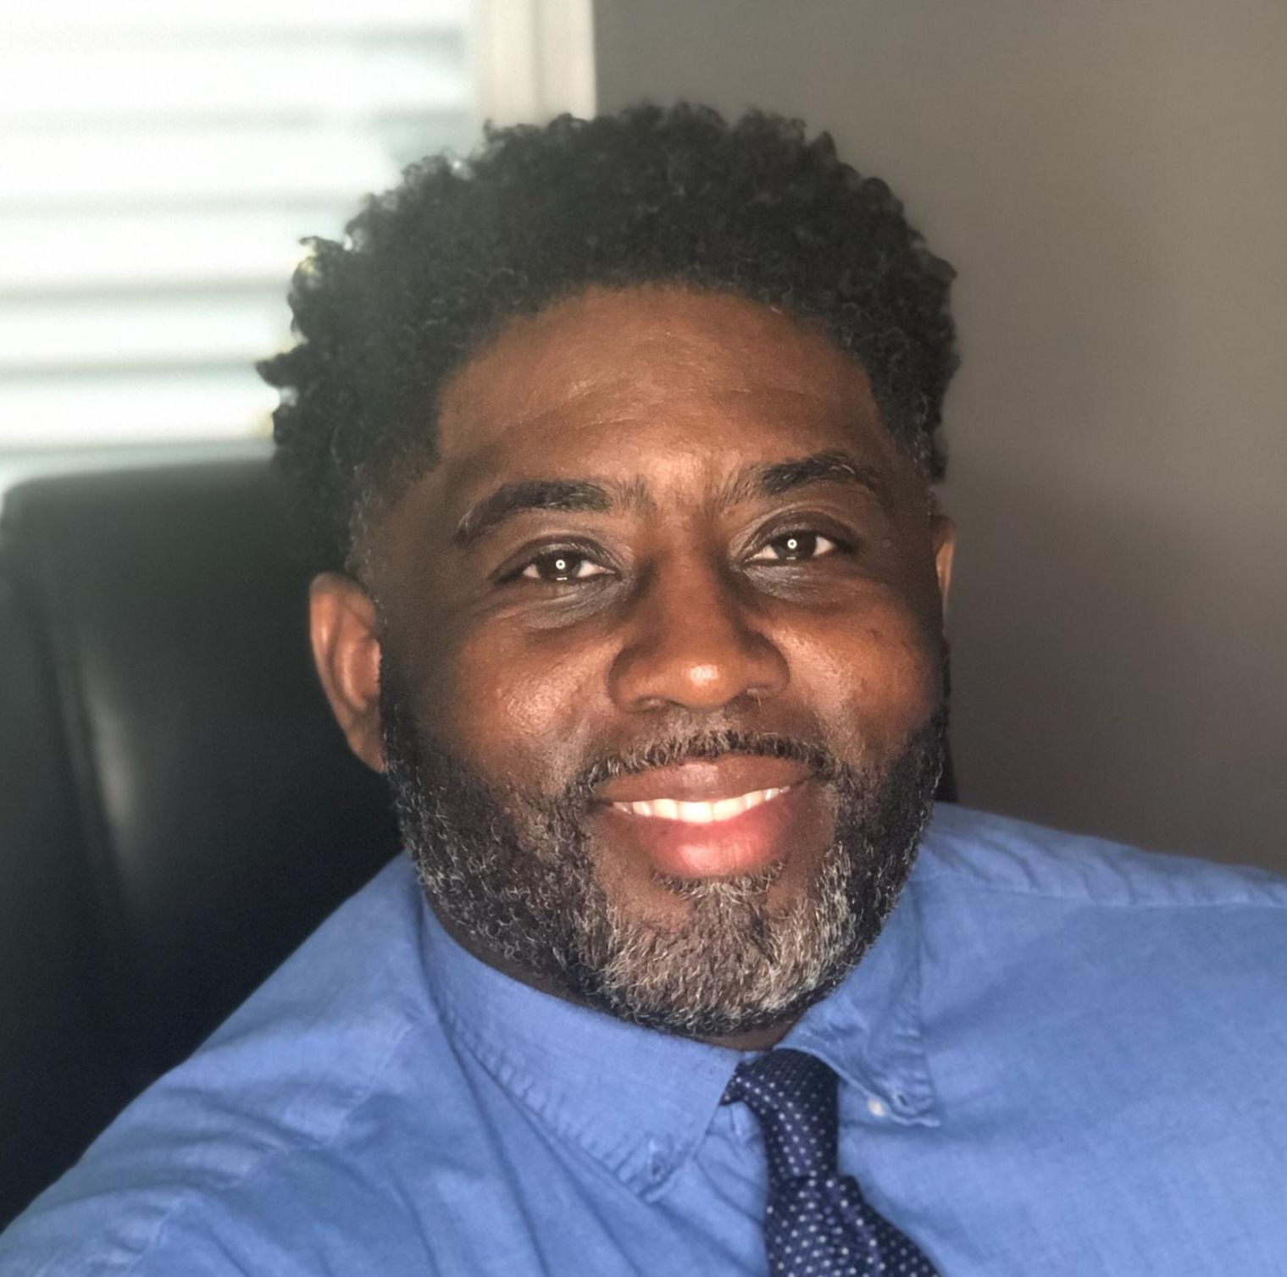
CONNECT AND BUILD YOUR WORKFORCE WITH APPRENTICESHIPNC!
You Have an Apprenticeship, Now What?
Michael Holmes
Michael oversees EGGER’s Apprenticeship Training Program, a paid, four-year program offering students on-site training and a scholarship to earn an associate degree while carving a pathway for employment. As part of his role building the company’s apprenticeship program in the U.S., Michael serves as co-chair of the Davidson-Davie Apprenticeship Consortia, which comprises six manufacturing companies in Davidson and Davie Counties.
Corporate Training Manager
Egger Wood Products, LLC

Slide 31
Poll

Slide 32
Five Minute Break

Slide 33
2021 Annual Conference
CONNECT AND BUILD YOUR WORKFORCE
WITH APPRENTICESHIPNC!
Tuesday, April 27th

Slide 34
Award for:
Outstanding High School Apprentice

Slide 35
Video here

Slide 36

Outstanding High School Apprentice
Perry Sharpe
High Point Fleet Services

Slide 37
2021 Annual Conference
Tailor Made:
Using Apprenticeship to Get the Right Fit

Slide 38
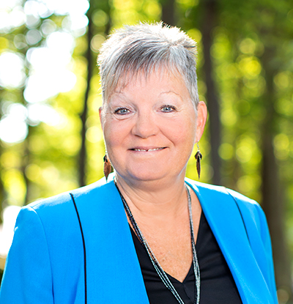
CONNECT AND BUILD YOUR WORKFORCE WITH APPRENTICESHIPNC!
Tailor Made: Using Apprenticeship to Get the Right Fit
Dr. Pamela Howze
Moderator
Dr. Pamela Howze leads Wake Technical Community College’s efforts to expand apprenticeship and work based learning. Prior to joining Wake Tech, she served as Program Director for the National Fund for Workforce Solutions, where she expanded apprenticeship and work-based learning programs. She was the statewide director of Apprenticeship, Business, and Veterans Services for the North Carolina Department of Commerce/NC-Works.
Executive Director Apprenticeship Work Based Learning and
Customized Learning
Wake Technical Community College

Slide 39

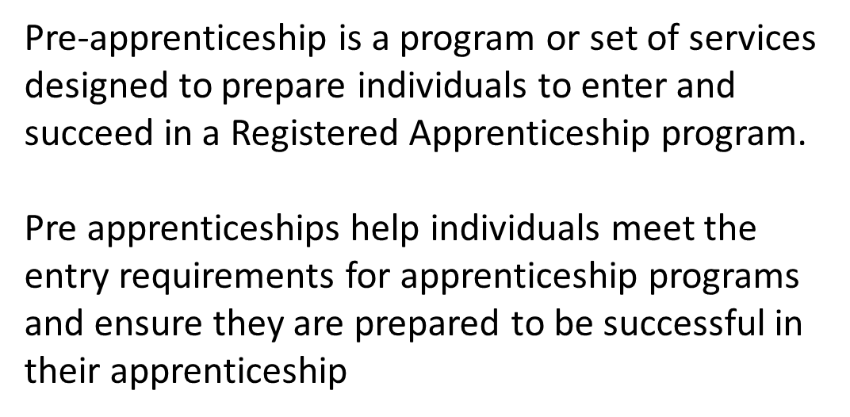
Tailor Made: Using Apprenticeship to Get the Right Fit

Slide 40

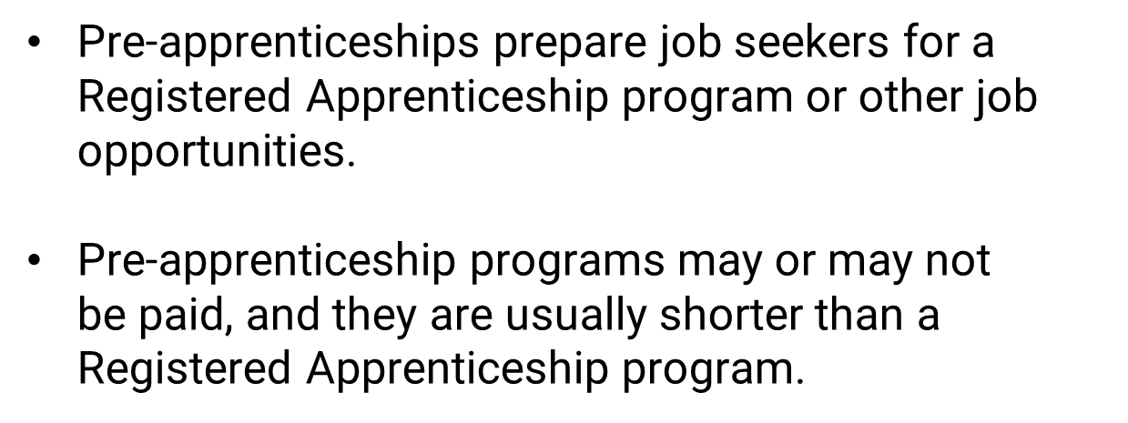
Tailor Made: Using Apprenticeship to Get the Right Fit

Slide 41

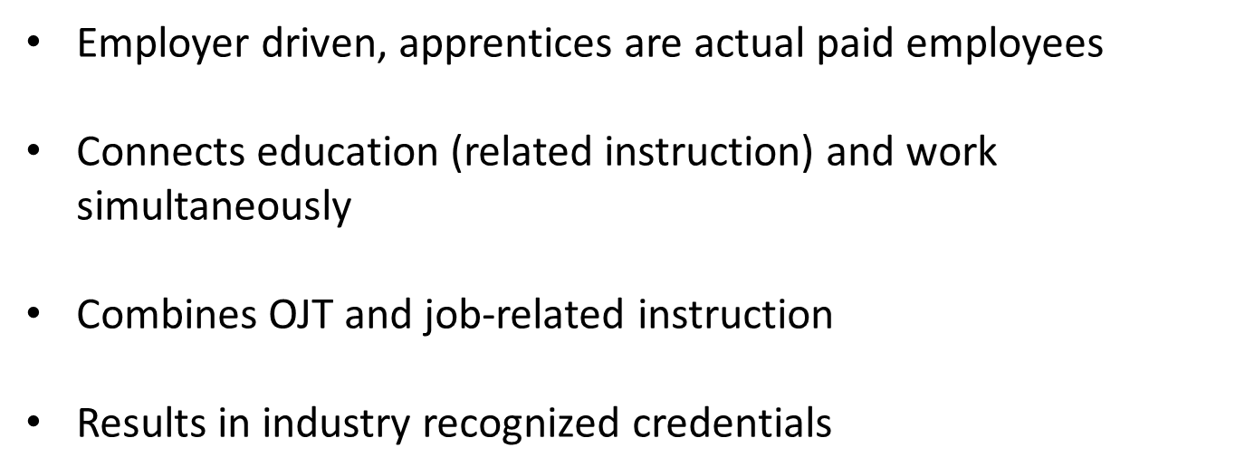
Tailor Made: Using Apprenticeship to Get the Right Fit

Slide 42
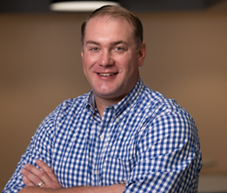
CONNECT AND BUILD YOUR WORKFORCE WITH APPRENTICESHIPNC!
Tailor Made: Using Apprenticeship to Get the Right Fit
Mark Bertoncino
Mark leads the customer service team for Bühler Aeroglide, providing parts, services and retrofits for industrial drying applications around the world. Aeroglide was founded in 1940 in Cary NC, and purchased by the Bühler Group in 2008. Founded in 1860, Bühler is a privately owned Swiss company with over 14,000 employees, working to create innovative solutions for safe and healthy food and feed, and ensure better mobility for the future through advanced materials.
Director of Customer Service
Bühler Aeroglide

Slide 43
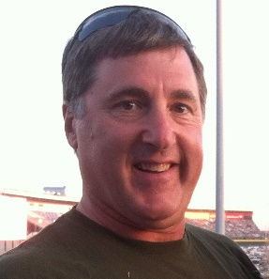
CONNECT AND BUILD YOUR WORKFORCE WITH APPRENTICESHIPNC!
Tailor Made: Using Apprenticeship to Get the Right Fit
Dr. Frank Scuiletti
Frank had worked over twenty years as an automotive and heavy truck technician before transitioning to teach automotive technology at our community colleges for nine years. He then became a community college program administrator for the NC Community College System where he’s been employed for over fourteen years.
Senior Program Administrator
NC Community College System

Slide 44

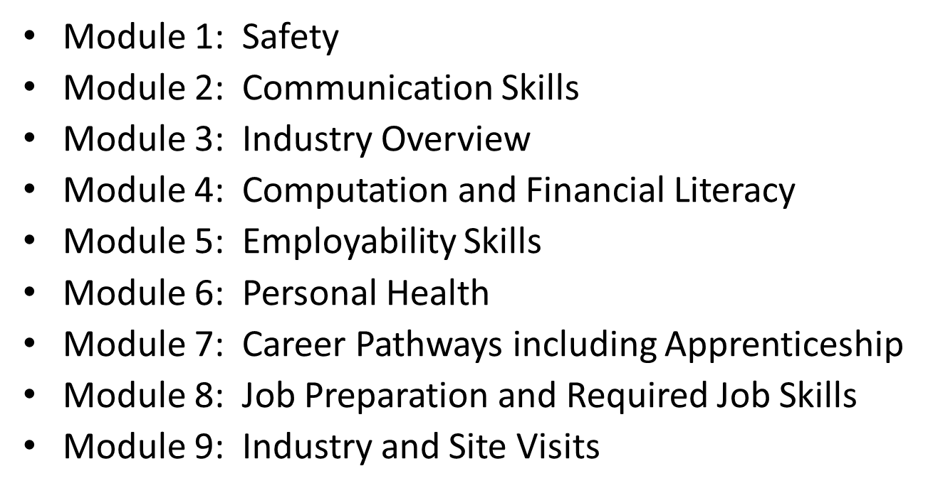
Tailor Made: Using Apprenticeship to Get the Right Fit

Slide 45
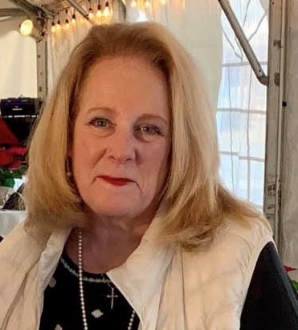
CONNECT AND BUILD YOUR WORKFORCE WITH APPRENTICESHIPNC!
Tailor Made: Using Apprenticeship to Get the Right Fit
Cheryl Cox
Cheryl has served in both the K-12 and post-secondary environments. Her former roles as a classroom teacher, Adjunct Professor, Career Development & Special Populations Coordinator, School-to-Career Coordinator and Academy Director helped lead her to her present position as the Work-based Learning Consultant for the NC Department of Public Instruction in Career and Technical Education.
Work-Based Learning Consultant
NC Department of
Public Instruction

Slide 46

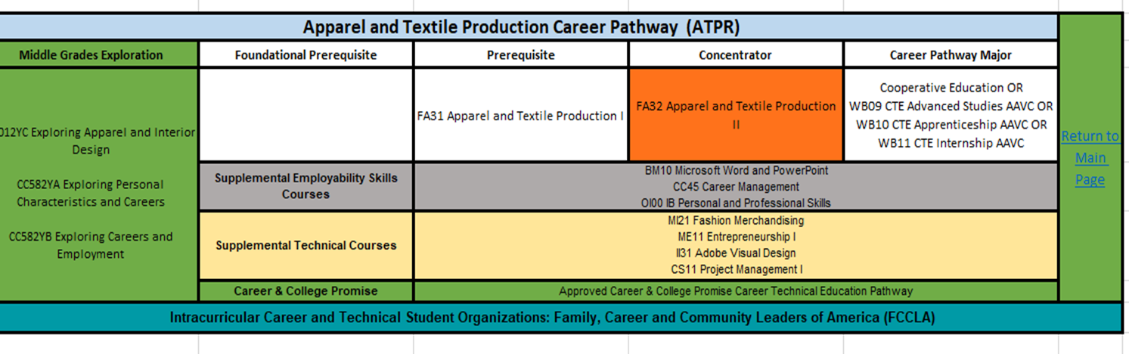
Tailor Made: Using Apprenticeship to Get the Right Fit

Slide 47
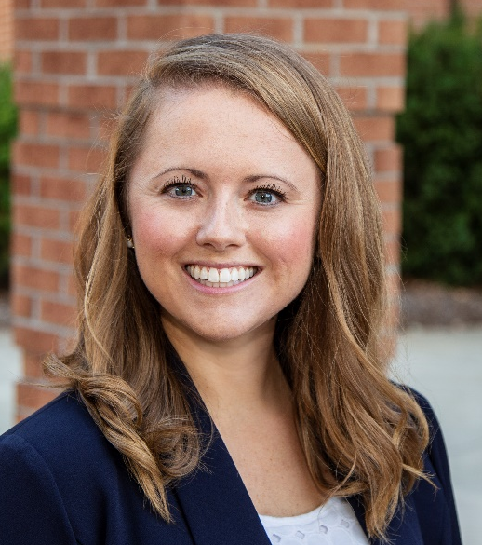
CONNECT AND BUILD YOUR WORKFORCE WITH APPRENTICESHIPNC!
Tailor Made: Using Apprenticeship to Get the Right Fit
Danielle Rose
Danielle works as Apprenticeship Coordinator with Forsyth Technical Community College in Winston-Salem, NC. She oversees LEAP@ForsythTech (Learn and Earn Apprenticeship Program) and the Toyota TTEN statewide apprenticeship program. She serves as the Forsyth County Goodwill Business Advisory Council chair and was named a 2019 Winston-Salem Chamber of Commerce “Top Leader Under 40”.
Apprenticeship Coordinator
Forsyth Technical
Community College

Slide 48

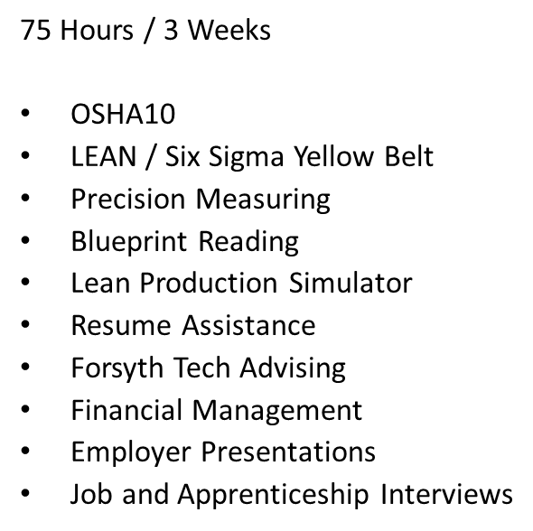
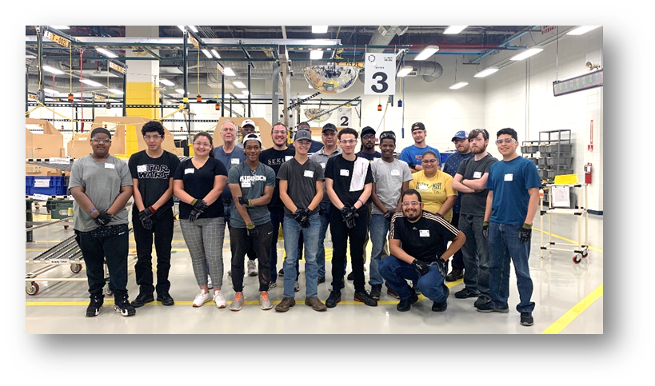
Tailor Made: Using Apprenticeship to Get the Right Fit

Slide 49
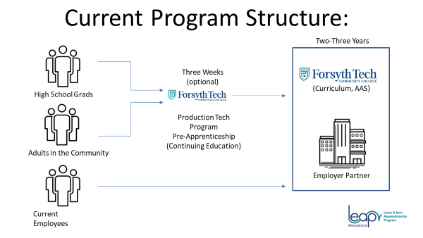
Tailor Made: Using Apprenticeship to Get the Right Fit

Slide 50
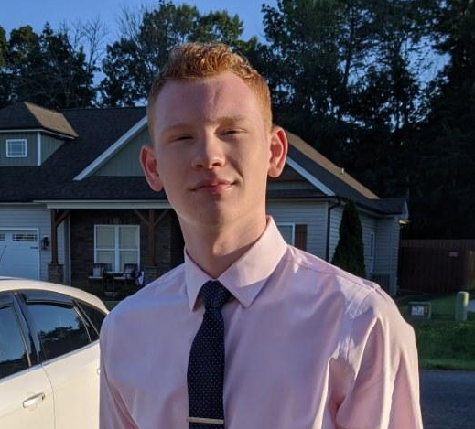
CONNECT AND BUILD YOUR WORKFORCE WITH APPRENTICESHIPNC!
Tailor Made: Using Apprenticeship to Get the Right Fit
Cance A. Cardwell
Cance is currently a student / apprentice taking part in the LEAP program at Forsyth Tech. He is in the mechatronics program at Forsyth Tech and works as an Apprentice Change Over Technician at Herbalife.
Apprentice
Change Over Technician
Forsyth Technical
Community College
and Herbalife

Slide 51
Poll

Slide 52
Closing Q&A
Tomorrow’s Conference
starts at 8:30am

Slide 53
Day 2 Agenda
2021 Annual Conference
Learn How ApprenticeshipNC
Can Help You Build Your Workforce
TIME | EVENT
8:30am | Conference Opens
8:30am | Opening Speaker: Maureen Little
8:35am | Outstanding Registered Apprenticeship Employer recognition
8:40am | Skills Gap or Opportunity Gap?
9:20am | Outstanding Pre-Apprenticeship Program recognition
9:25am | Questions About Sustaining Your Future Workforce?
10:15am | Outstanding Consortium Member recognition
10:20am | Supporting Our Veterans in Apprenticeship
11:00am | Outstanding Apprenticeship Partner recognition
11:05am | Closing Session Tariq Bokhari

Slide 54
Thank You Sponsors

