Slide 1
North Carolina Apprenticeship Expansion Funds Session Law 2021-180 Section 16.4

Slide 2


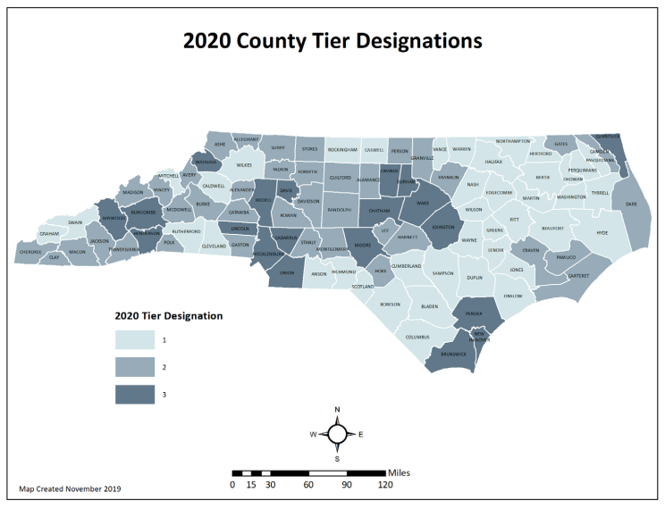


Background and General Information
Funding Source: North Carolina General Assembly
Funding Target:
Business is in a Tier 1 or Tier 2 County
Business is a “small business” with less than 500 employees
Business is hiring new apprentices ages 16-25
Business is registering an occupation in a career considered “high demand”
$12 million in non-recurring funds to be spent through December 31, 2026

Slide 4



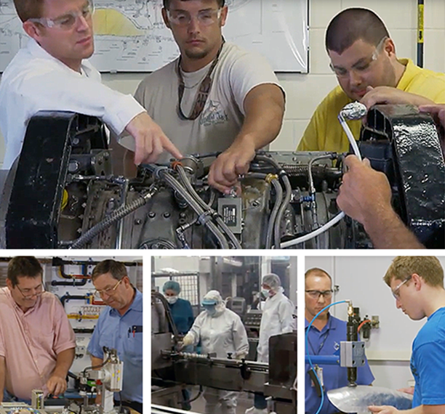

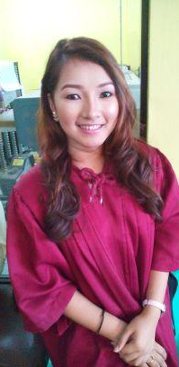
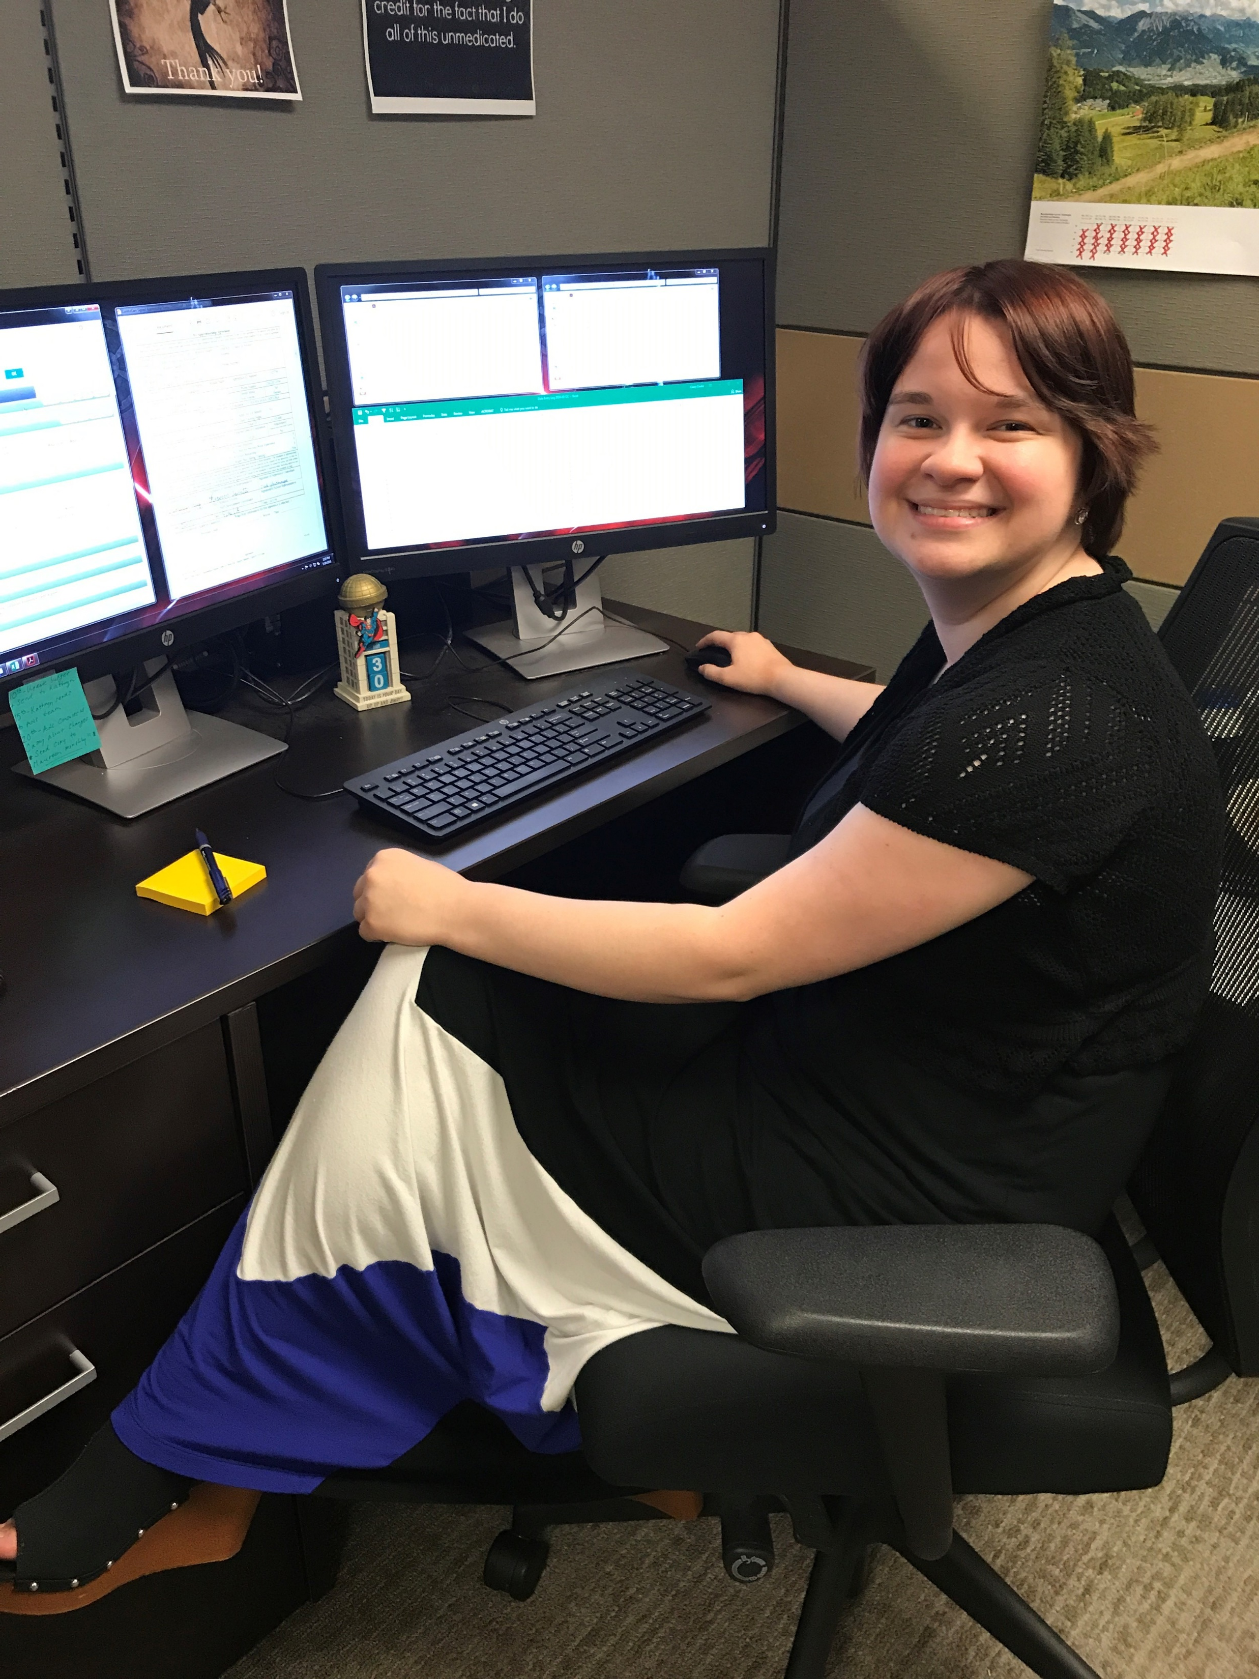
Background and General Information:
(15-0000) Computer and Mathematical (includes IT)
(17-0000) Architecture and Engineering
(25-0000) Education
(29-0000) Healthcare Technicians
(31-0000) Healthcare Support
(33-0000) Protective Service
(35-0000) Food Preparation and Service
(43-0000) Office and Administrative Support
(47-0000) Construction and Extraction
(49-0000) Installation, Maintenance, and Repairs
(51-0000) Production
(53-0000) Transportation
High Demand Careers List for General Assembly Apprenticeship Funding
2-Digit Occupation Codes

Slide 5




Funding Permissives
Training Costs
$2,000 Per NEW Apprentice for the first year
Paid to: Employer by Local Community College
Tuition, Books, and Fees
$2,500 per year per NEW Apprentice for two years ($5,000 max)
Paid to: Employer by Local Community College

Slide 6


Funding Permissives
Salary Match for 1 Year:
NEW Apprentices who are NOT in high school
50% reimbursement based on the registered wage scale *reimbursement cap of $15/hr.
Paid to: Employer by Local Community College
Salary Match for 1 Year:
NEW Apprentices who ARE in high school
50% reimbursement based on the registered wage scale *reimbursement cap of $14/hr.
Paid to: Employer by Local Community College

Slide 7
Funding Requirements
Funds must be obligated by December 31, 2024
Funds must be spent by December 31, 2026
Invoices must be processed at the local Community
College within 45 days of the first day of class
Yearly monitoring reviews will be held each June with
ApprenticeshipNC and the Community College

