Slide 1
2020 ApprenticeshipNC
The Time is NOW
Create Your Workforce with ApprenticeshipNC

Slide 2
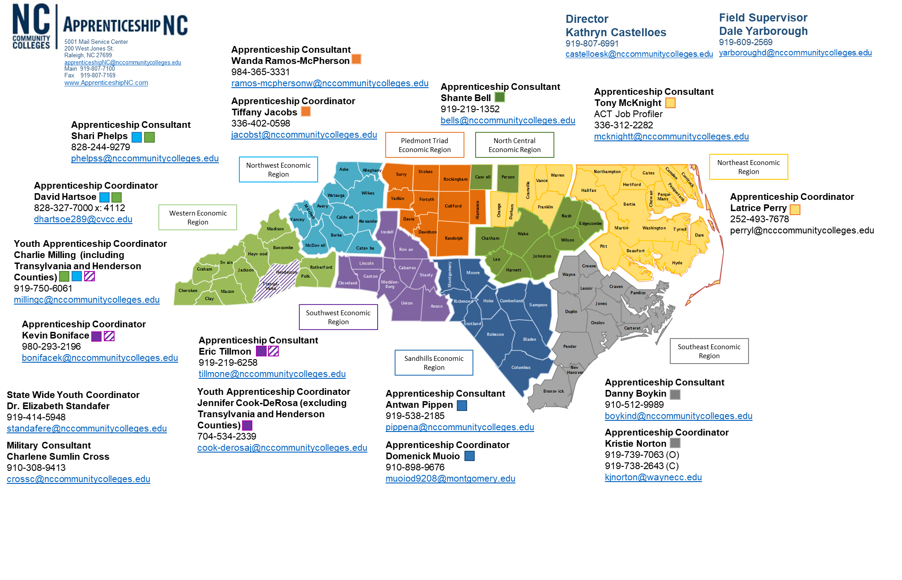
Youth Apprenticeship Manager

Slide 3
Sponsor Registrations
As of 1/1/2020

Slide 4
Apprentice Registrations
As of 1/1/2020

Slide 5
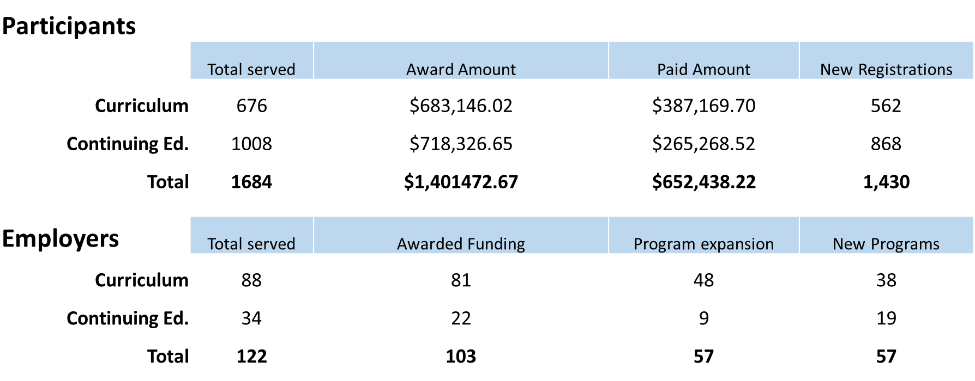
State Apprenticeship Expansion Education Awards
1/1/2020

Slide 6
Apprenticeship State Expansion:
Education Assistance Update

Slide 7
Partnership to Advance Youth Apprenticeship
Grant received: $150,000
Hired 2 Apprenticeship Coordinators
Target Industry Sectors
  Hospitality - Western NC
  Financial/Information Technology - Piedmont NC
  Agribusiness - Northeastern NC

Slide 8
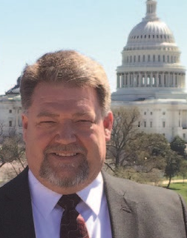
Roger Collins
Apprenticeship Manager and Technical Training Specialist for
Siemens Energy Inc.

